Slide 2
Lesotho Country Prospective; PrEP and STI’s Challenges and Opportunities
Dr Tapiwa Tarumbiswa
HIV & AIDS Manager Ministry of Health Lesotho

Slide 3
KEY-POINTS
Lesotho has a high HIV disease burden.
PrEP services have been provided for the past 18months.
Phased scale up has enrolled 11,887 clients on PrEP services.
Eligibility criteria has shifted from sexual orientation to sexual risk in the new guidance.
High 1 month discontinuation rates can be improved by;
Providing differentiated care- flexi hours
Better monitoring and evaluation
Focusing PrEP to the right people (Sero discordant, FSW, MSM, AYGW –individualized screening and service delivery

Slide 4
LESOTHO
Lesotho is a landlocked country in Southern Africa surrounded by South Africa
Population: 2.2 million
Highly mobile population (~20% reside in South Africa)
Mountainous and difficult terrain

Slide 5
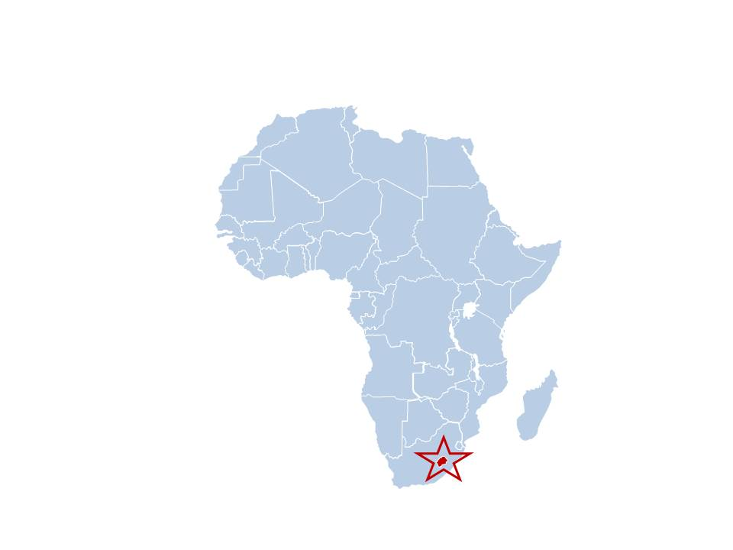
HIV in Lesotho
Adults: 15+ years New infections
HIV prevalence 25.6% (15-59 years):
30.4% females; 20.8% males
2.1% among children 0-14 yrs
2.6% females;1.5% males
Adult Peak prevalence
Females 49.9% (35-39 years)
Males 46.9% (40-44years)
Estimated PLHIV 330,000
74% ART coverage
73% PMTCT Coverage;
72% TB/HIV co-infection
1.1% Incidence rate (1.0% females, 1.2%);
Approx. 10,000 new infections annually
CLHIV: 15,313; 1,400 new infections annually

Slide 6
HIV in Lesotho
Progress towards 90, 90, 90 targets
HIV Prevalence KP;
Female sex workers (FSW)- 73.3%
Factory workers- 44.7%
Men who have sex with men (MSM)- 35.4%
Inmates-31. 4%

Slide 7
PrEP Intervention Lesotho
Phased scale up of PrEP services both facility and community (Maseru, Berea and Mafeteng)-3 districts
2018
National roll out of PrEP services
Eligibility criteria now based on sexual activity risk
2019
Test and Treat along with PrEP Policy adopted 2016.
PrEP regimen-TDF/3TC
Eligibility criteria 2017- based on sexual orientation
PrEP delivery both facility and community based
2017

Slide 8
PrEP Enrolment
Total Initiated on PrEP- 11,887
Notes:
An average of 1981 new PrEP clients per quarter = 660 per month

Slide 9
PrEP Continuation Rates
Notes:
Few clients at the beginning few clients easy to manage using VHW. Struggled to get them back. From Jan tracking weekly the teams data display and reaction getting feedback, differentiated care flexi hours, engaging parents, targeting improving giving PrEP to the right people on PrEP (Sero discordant, MSM, FSW –individualized screening and service delivery).

Slide 10
Sero-conversion on PrEP
6 documented sero-converters in 18 months
5 clients tested positive after 30 days of PrEP use
1 client tested positive in the 5th month of PrEP use with documented poor adherence.
All 6 clients are on 1st line ART regimen and are virologically suppressed.

Slide 11
Stakeholders Perspectives on Scaling up PrEP for HIV Prevention Lesotho Study Overview:
Goal | To gain a deeper understanding of ongoing PrEP program and scale up process across the health system
Objectives | To document successes, challenges, and areas of improvement, from diverse perspectives; To understand current PrEP uptake and reach; and To gather views on how uptake of, and retention in PrEP could be increased
Methodology | Qualitative methods 106 Semi-structured in-depth interviews with: Policy makers (n=5) Implementing partners (n=4) Current PrEP users (n=55): including those in sero-discordant relationships; FSWs etc. Former PrEP users (n=36) High-risk decliners (n=6) 11 semi-structured focus group discussions with 105 health providers
Study duration | 5 months (February-June 2019)

Slide 12
Key Preliminary Findings
Positive attitudes and favorable view of PrEP across respondent groups, who describe it as a “good thing” and a “gift from God”, due to positive impact on user’s life:
Negative attitude (minority): PrEP promotes promiscuity
High PrEP awareness among key populations, but limited awareness in general population
Awareness compounded by misconceptions about pill’s function, including:
PrEP protecting against pregnancy and STIs
PrEP use means user is HIV positive
PrEP confers immediate protection from HIV
Single PrEP dose confers life-long protection
PrEP makes you gain weight- “appetite pill”
Efficacy:
“Would I really remain negative?” Male current PrEP user, 36 years
Side effects and safety:
Perceived and experienced side effects reported as barrier to uptake and adherence
Notes:
Opportunities;
To increase health education and advocacy Awareness across entire population addressing misconceptions the general public holds towards PrEP.
Encourage PrEP manufactures to alter PrEP packaging to distinguish it from ART

Slide 13
Key Preliminary Findings
PrEP limited availability of TDF/3TC globally threatening Lesotho supply chain.
STI and Family planning services not yet fully integrated with PrEP service.

Slide 14
Summary recommendations
Consider the following when scaling up PrEP;
Phased approach
Should be accompanied with health education and advocacy across the entire population addressing misconceptions the general public may hold towards PrEP.
Integrate routine STI and family planning services with PrEP
High 1 month discontinuation rates can be improved by;
Providing differentiated care flexi hours
Better monitoring and evaluation
Focusing PrEP to the right people (Sero discordant, FSW, MSM,AYGW –individualized screening and service delivery).

Slide 15
Acknowledgements
U.S. President's Emergency Plan for AIDS Relief (PEPFAR) and WHO
Implementing partners community PrEP-Jhpiego, facility PrEP- Elizabeth Glaser Paediatric Foundation.
Stakeholders Perspectives on Scaling up PrEP for HIV Prevention- Lesotho Study
Clinton Health Access Initiative-Lesotho (CHAI)
Till Bärnighausen (University of Heidelberg, Germany)
Shannon McMahon (University of Heidelberg, Germany)
Pascal Geldsetzer (Harvard University, USA)
Joy Chebet (University of Arizona, USA)

Slide 16
THANK YOU

